Slide 1
Problems

Slide 2
Types of Computer
There are many different types of computer:
general purpose - PCs, Laptops etc
specialised - servers, routers,microcontrollers

Slide 3
Functions
In general computers can do four things:
Input (accepts data)
Processing (processes data)
Output (produces output)
Storage (save results)

Slide 4
Example
Using one specific computing device (i.e. your smart phone) give examples of these four functions in action:
Type of Computer: Calculator
Numbers in a form of an equation.
Processes the equation, creating an answer
Produces an answer for said equation.
Calculator remembers the last equation processed.

Slide 5
Why Computers?
What advantages/disadvantages are there when using a computer for a task, compared to a human?
(list as many reasons as you can)
Less possibility of error.
Faster.
Less energy used.
Easier.
More efficient.
More accurate.

Slide 6
List some Apps that are used for...
Storing of information
iCloud
Google Drive
Email/Gmail

Slide 7
List some Apps that are used for...
Retrieving information
Safari, Google Chrome, Internet Explorer, Mozilla Firefox.

Slide 8
List some Apps that are used for...
Sending or communicating information

Slide 9
List some Apps that are used for...
Modifying or transforming information.
Photoshop, Microsoft Office, Paint Pro

Slide 10
Hardware/Software
What is the difference between hardware and software?

Slide 11
What are the following for?
CPU - Central Processing Unit
GPU - Graphics Processing Unit
RAM - Random Access Memory
Motherboard
Hard Drive

Slide 12
Software I
What is an operating system (OS) ? List some variants.

Slide 13
Software II
In relation to computer software, what are drivers?

Slide 14
Networks
What do computer networks allow us to do?
What is the difference between the world wide web (www) and the internet?

Slide 15
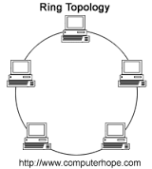
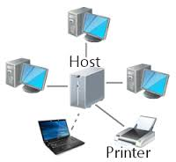
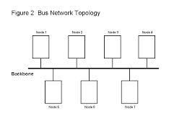
Network Topologies
What do the following network configurations look like?
Ring →
Star --------------->
Bus------------------------------------>
Which configuration do you think this lab uses?
Bus

Slide 16
Acronyms
Explain:
LAN - Local Area Network
WAN - Wide Area Network
MAN - Metropolitan Area Network

Slide 17
Protocols
A protocol is simply an agreed way of doing things. For instance, social protocol dictates that if someone greets you with “Dia duit” you reply with “Dia is Muire duit”
Computers have similar - albeit more robust - communication protocols.

Slide 18
What are these Protocols for?
SMTP/POP3 - SMTP stands for Simple Mail Transfer Protocol. SMTP is used when email is delivered from an email client, such as Outlook Express, to an email server or when email is delivered from one email server to another. POP3 stands for Post Office Protocol. POP3 allows an email client to download an email from an email server. The POP3 protocol is simple and does not offer many features except for download. Its design assumes that the email client downloads all available email from the server, deletes them from the server and then disconnects
FTP - The File Transfer Protocol (FTP) is a standard network protocol used to transfer computer files from one host to another host over a TCP-based network, such as the Internet. FTP is built on a client-server architecture and uses separate control and data connections between the client and the server.
TCP/IP - TCP/IP (Transmission Control Protocol/Internet Protocol) is the basic communication language or protocol of the Internet. It can also be used as a communications protocol in a private network. When you are set up with direct access to the Internet, your computer is provided with a copy of the TCP/IP program just as every other computer that you may send messages to or get information from also has a copy of TCP/IP.

